Slide 1
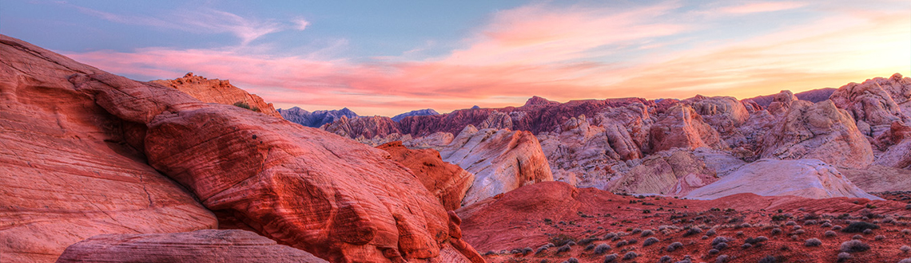

The relative importance of shelter on microclimate, plants, and animals in desert communities.
Ghazian Spring 2021 Progress Report

Slide 2
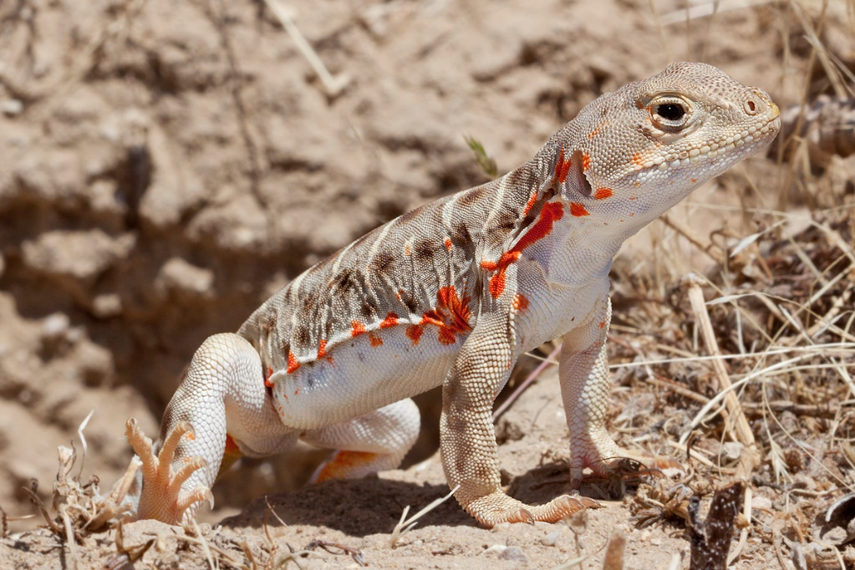
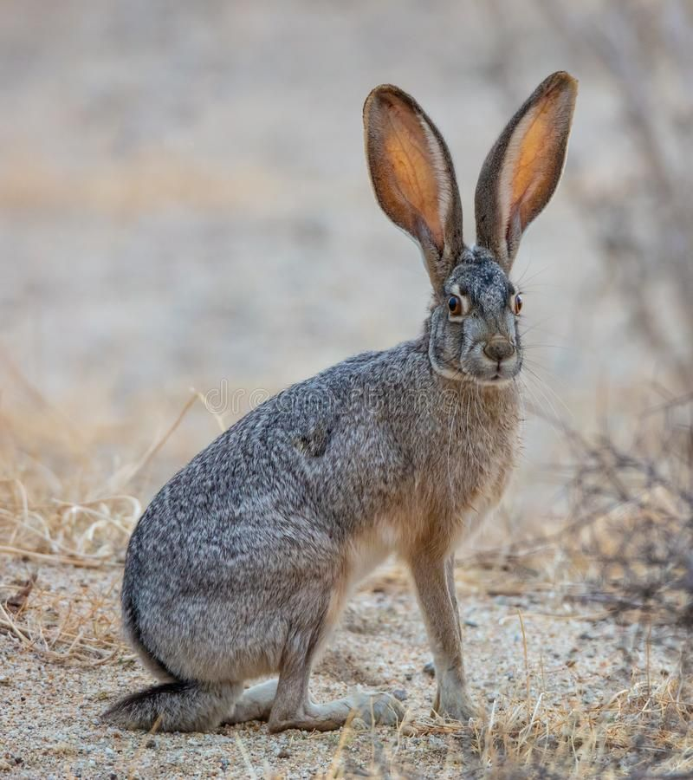
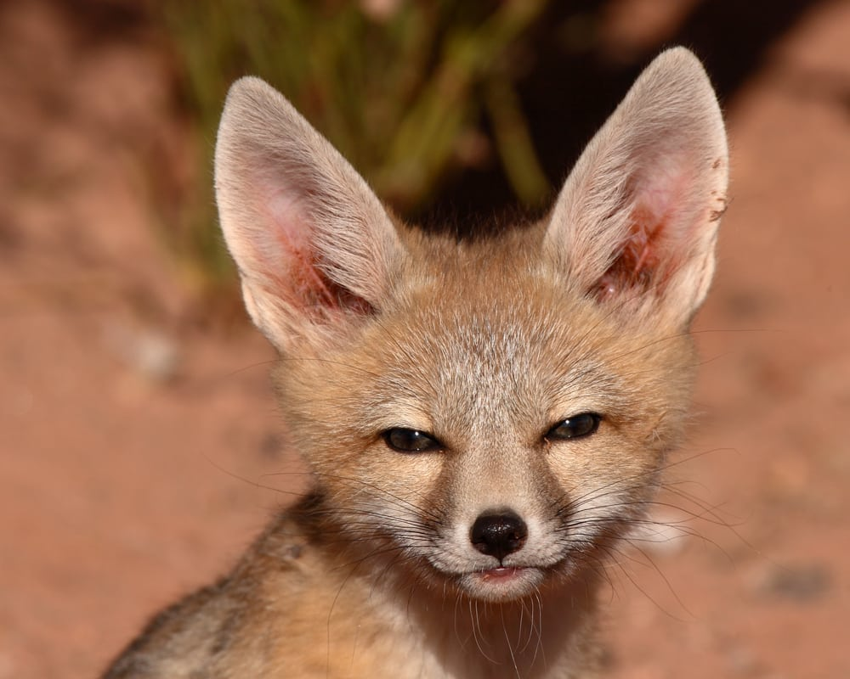
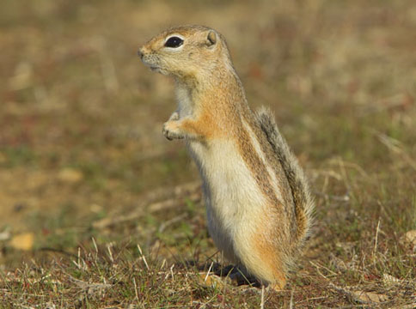
Background
Notes:
Long-term climate patterns can mediate reproduction and distribution (Bellard et al. 2012; Walther 2010)
but fine-scale, microclimatic data can impact the immediate day-to-day survival. Hence, the scale at which
climate is measured is important for different species.

Slide 3

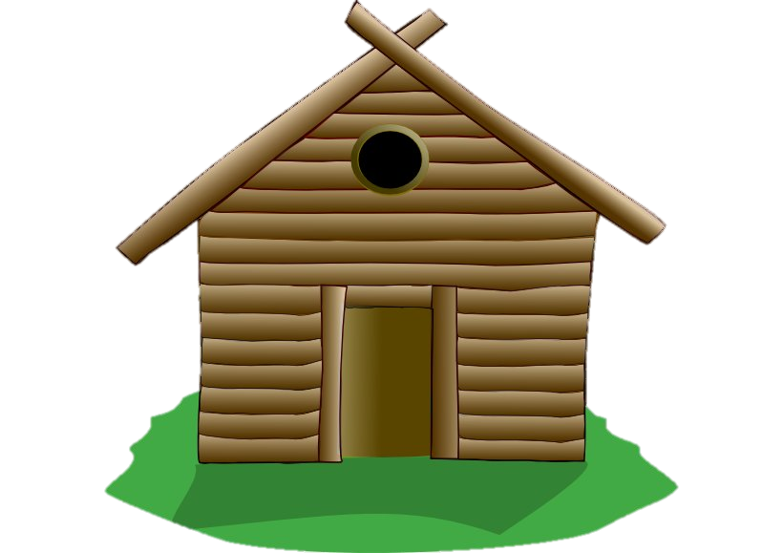

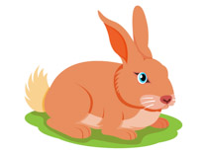

Slide 4
Main Objectives
Identify key sampling designs with camera traps.
Record microclimatic impacts of eco-friendly materials and their influence on plant species under controlled conditions.
Demonstrate ecological effects of shelters in the field.
Compile frequency and ecological strength of microclimate facilitation reported in the literature.

Slide 5
Main Objectives
Identify key sampling designs with camera traps.
Record microclimatic impacts of eco-friendly materials and their influence on plant species under controlled conditions.
Demonstrate ecological effects of shelters in the field.
Compile frequency and ecological strength of microclimate facilitation reported in the literature.

Slide 6
Chapter 1. Finding the sweet spot in camera trapping: a review of camera trap papers to test for reported sampling effort in population estimates.
Notes:
252 full-text articles. Using exclusion criteria, we included 119 studies.

Slide 7
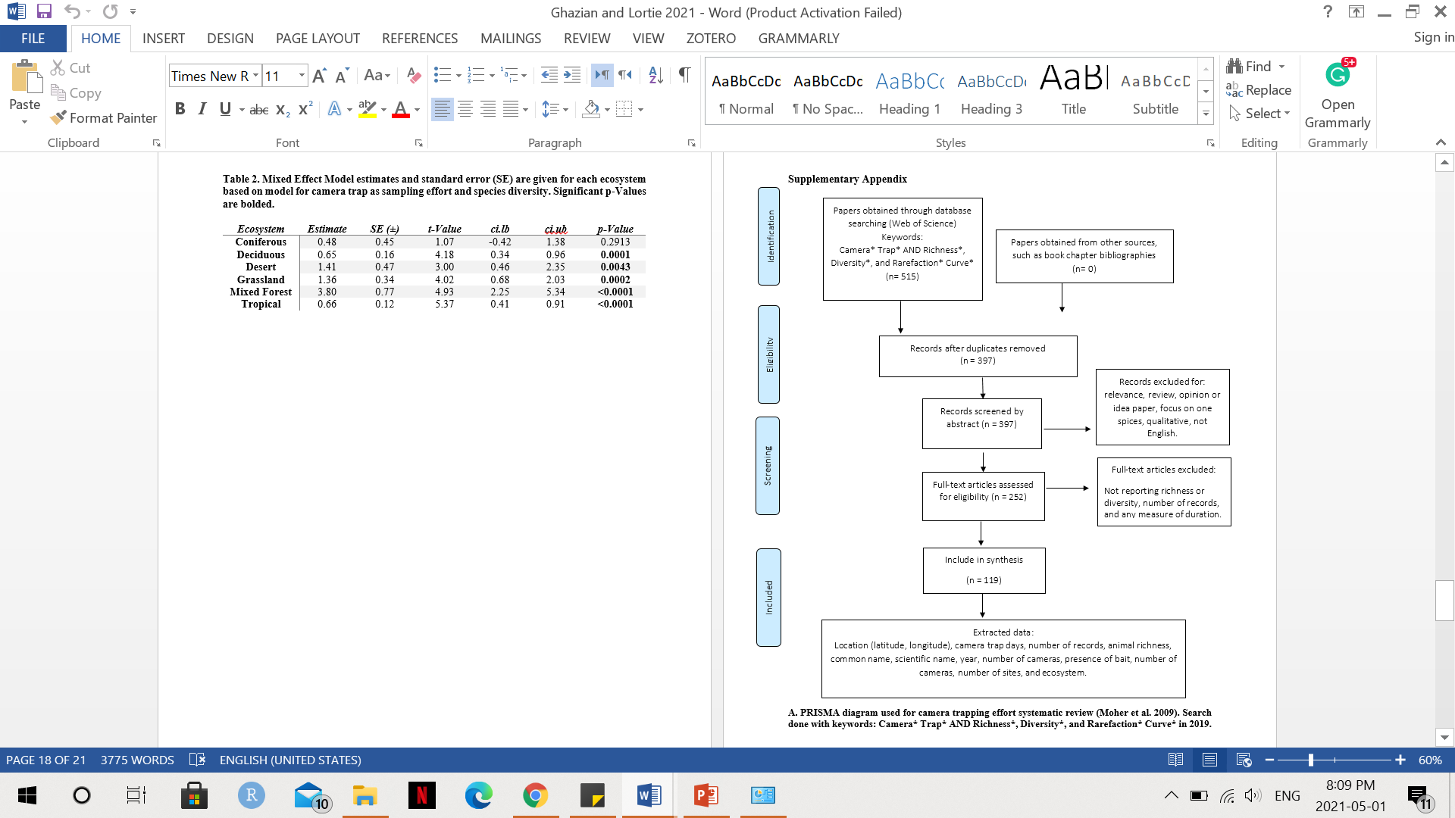

Slide 8
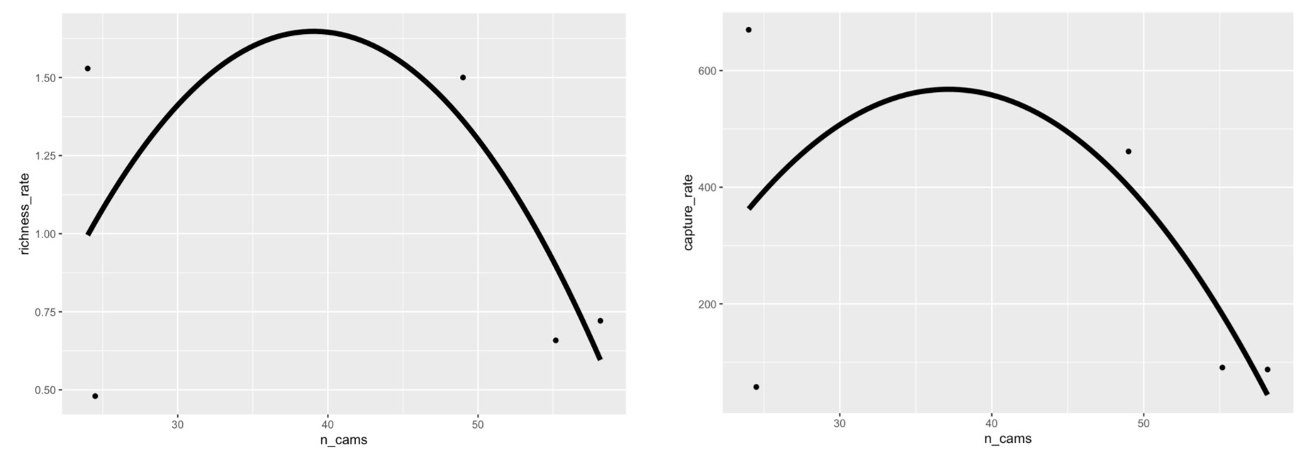

Slide 9
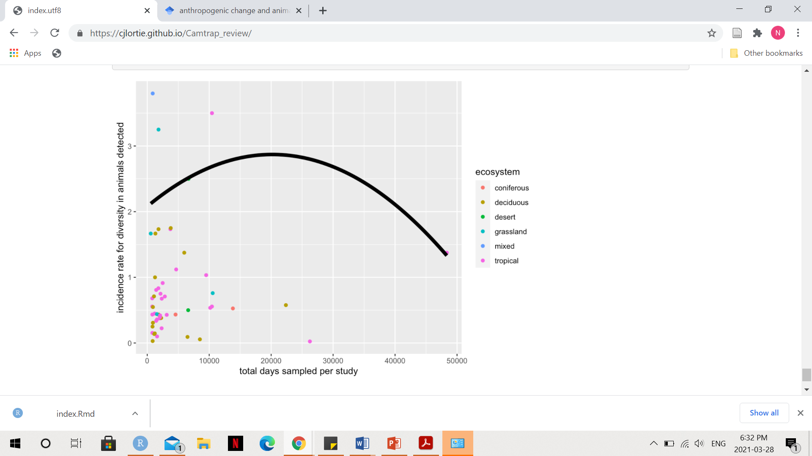

Slide 10
Main Objectives
Identify key sampling designs with camera traps.
Record microclimatic impacts of eco-friendly materials and their influence on plant species under controlled conditions.
Demonstrate ecological effects of shelters in the field.
Compile frequency and ecological strength of microclimate facilitation reported in the literature.

Slide 11
Chapter 2: Quantifying the extend of microclimatic amelioration of natural fabrics and estimating effects on native and exotic seedlings.

Slide 12
Purpose: To quantify the extent to which different natural fabrics facilitate the understory annual plant growth in comparison to the open gap.
Questions: How do different natural fabrics such as burlap, cotton, and nursery seedling cloth affect microclimatic parameters such as RH, temperature, and light? How do different fabrics affect understory annual growth? Are annuals and foundation plants facilitated to the same extend?
Hypothesis: Fabrics will lower the amplitude of variation in microclimatic parameters such as temperature, RH, and radiation relative to the open. Germination rates of annual plants and foundation species do not differ between different fabrics and it will all be higher than the open gap.

Slide 13
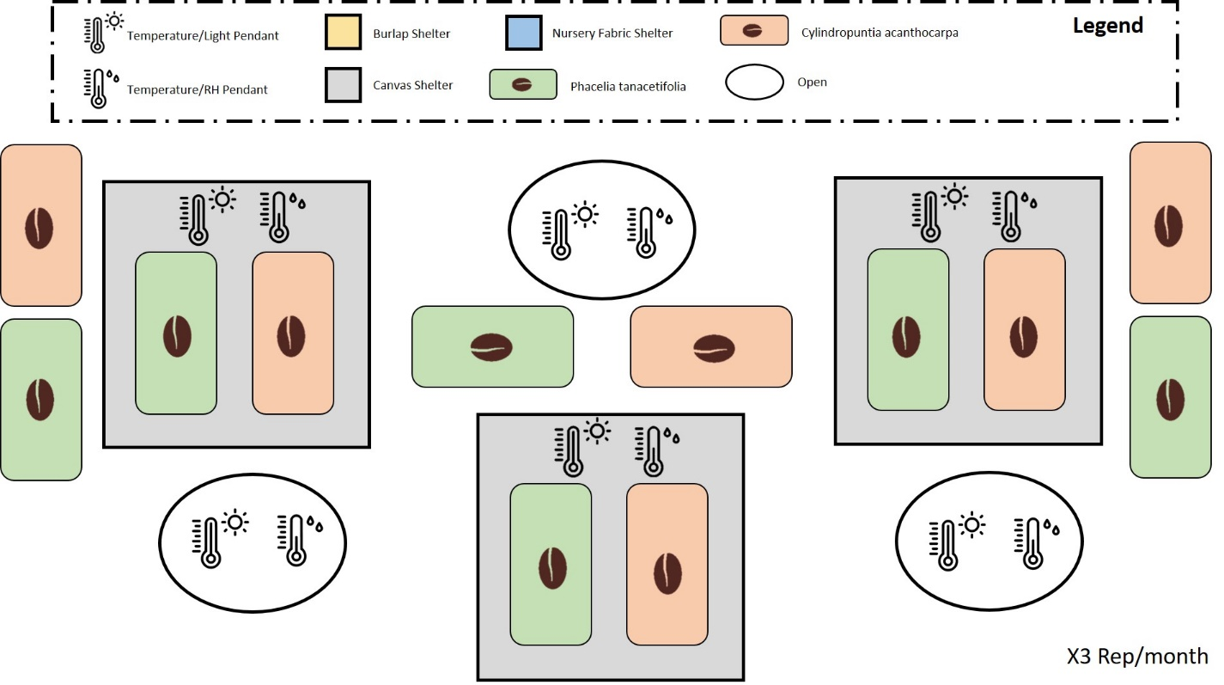

Slide 14
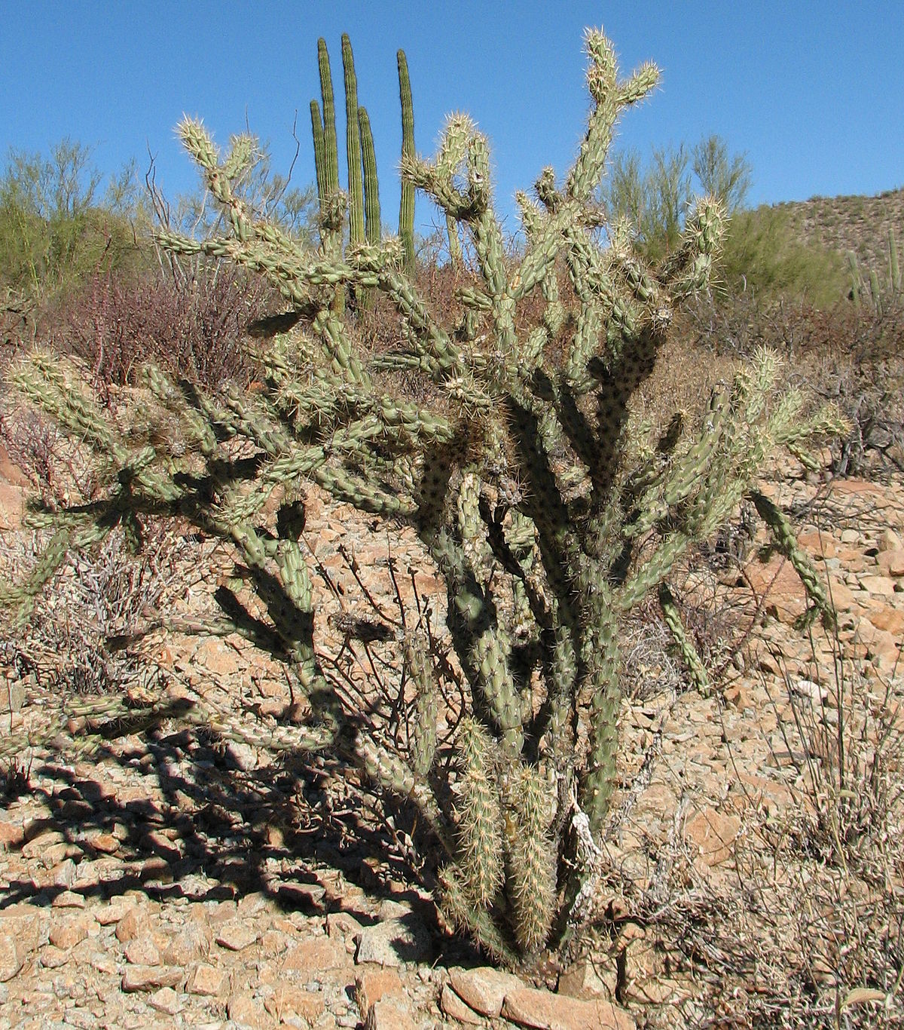
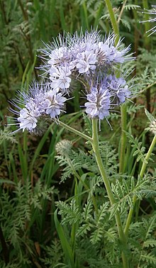
Cylindropuntia acanthocarpa
Phacelia tanacetifolia

Slide 15
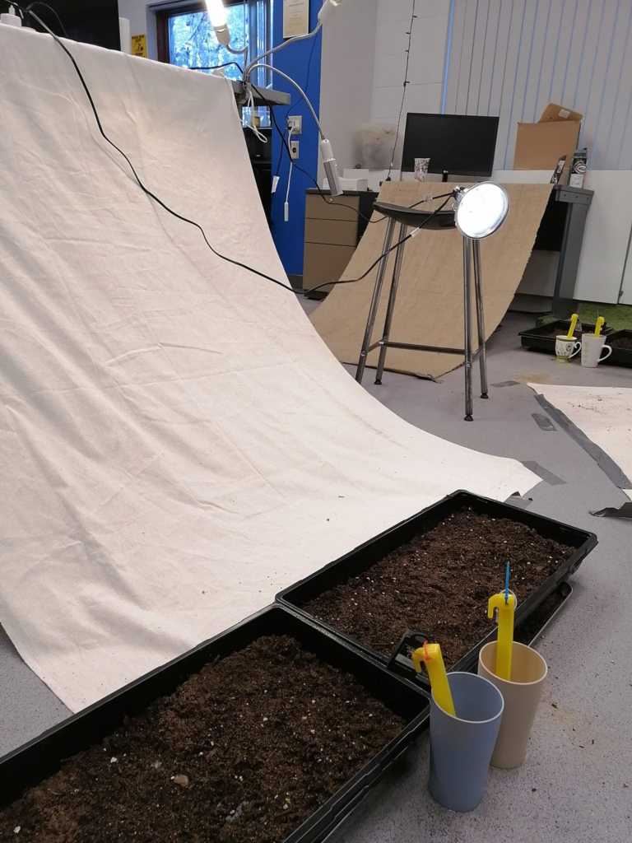
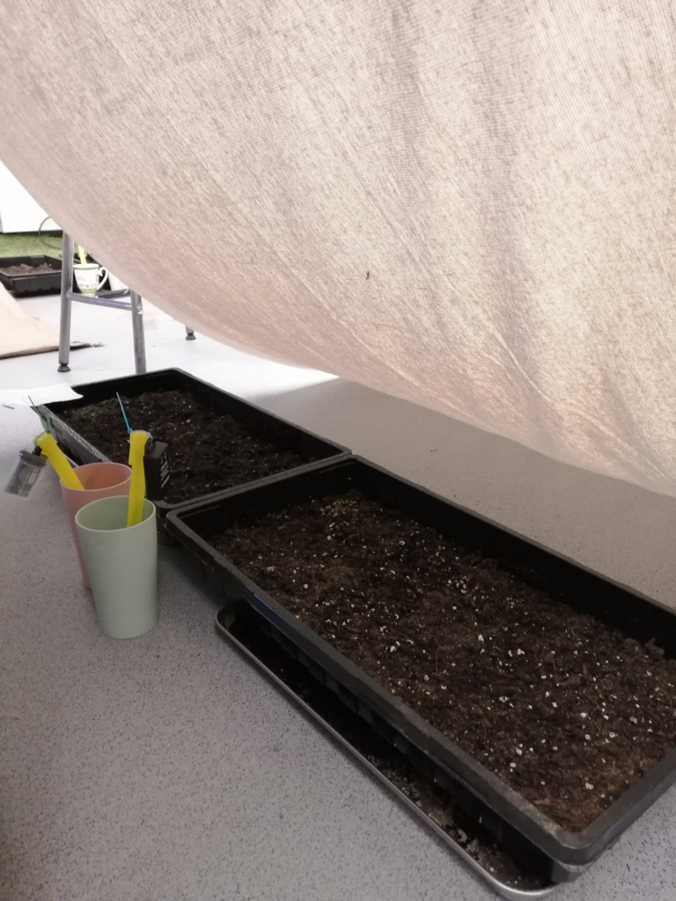

Slide 16
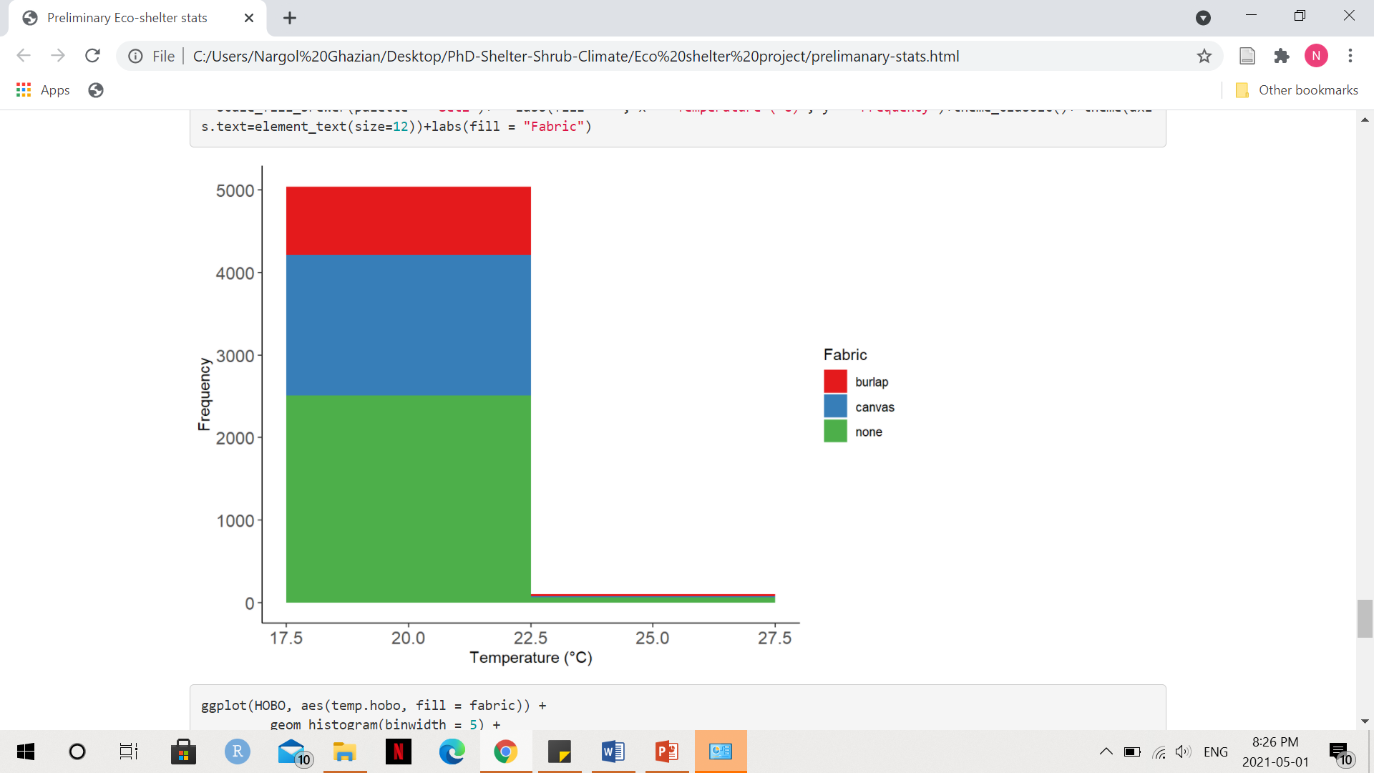

Slide 17
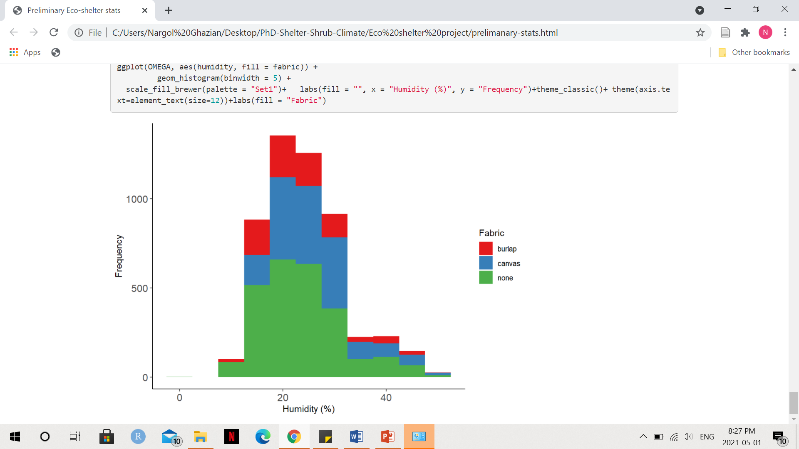

Slide 18
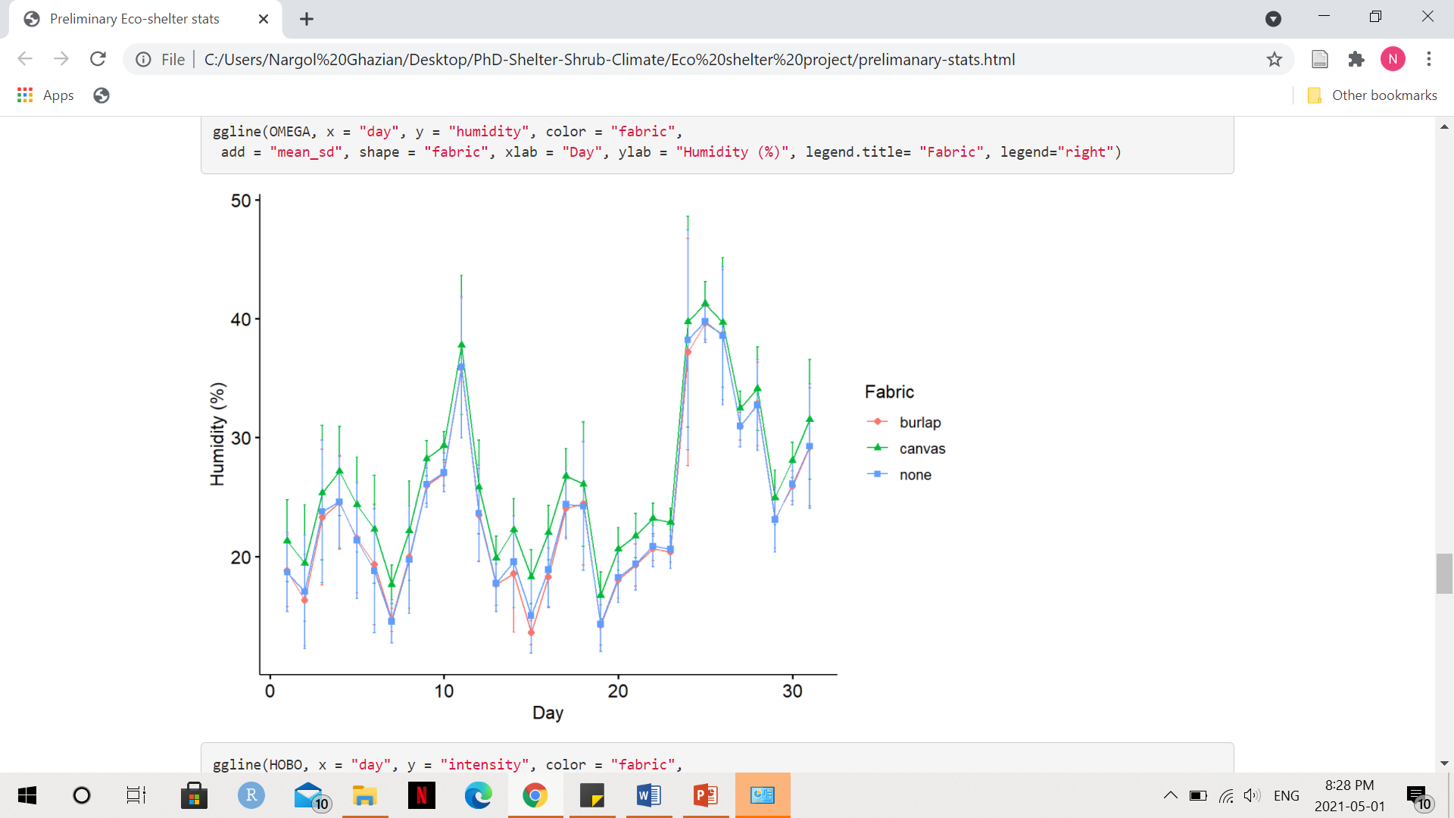

Slide 19
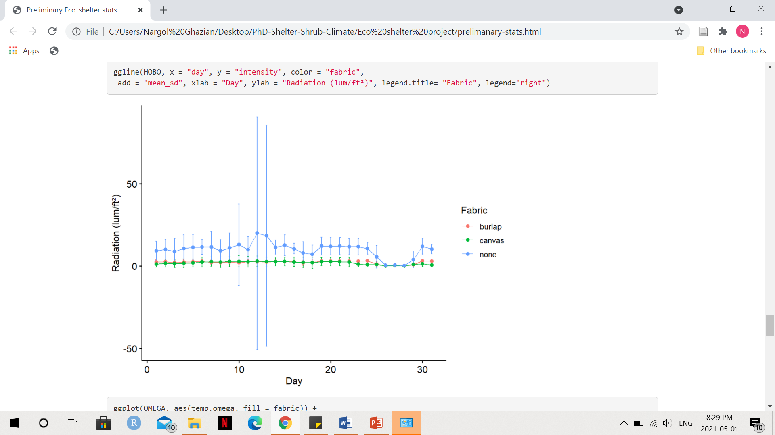

Slide 20
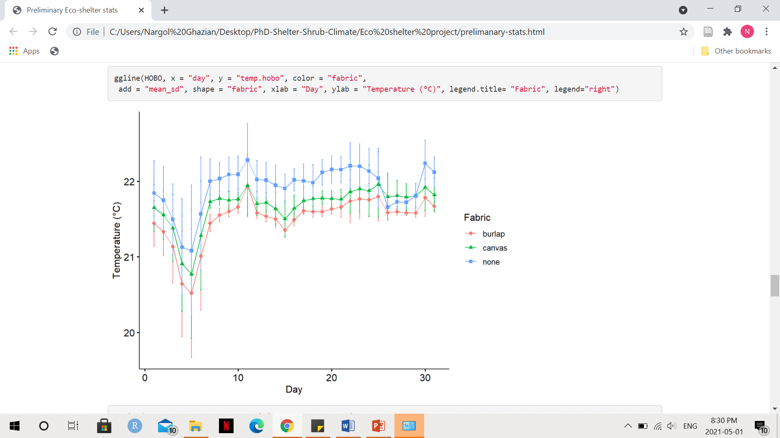
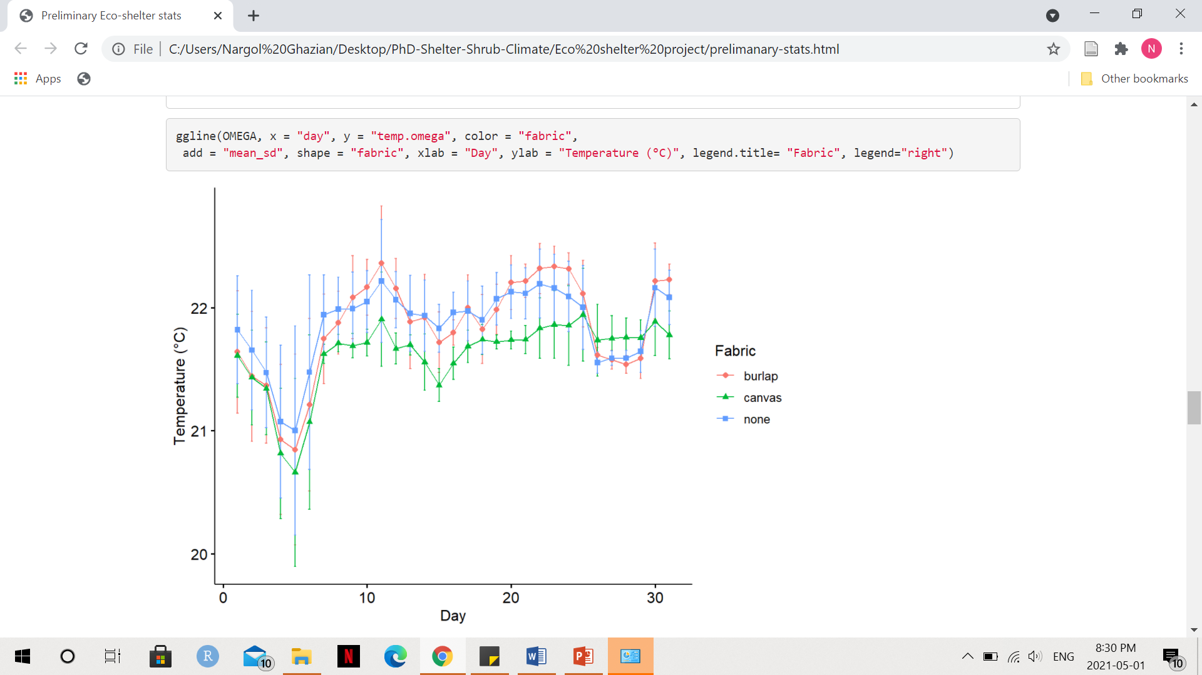

Slide 21
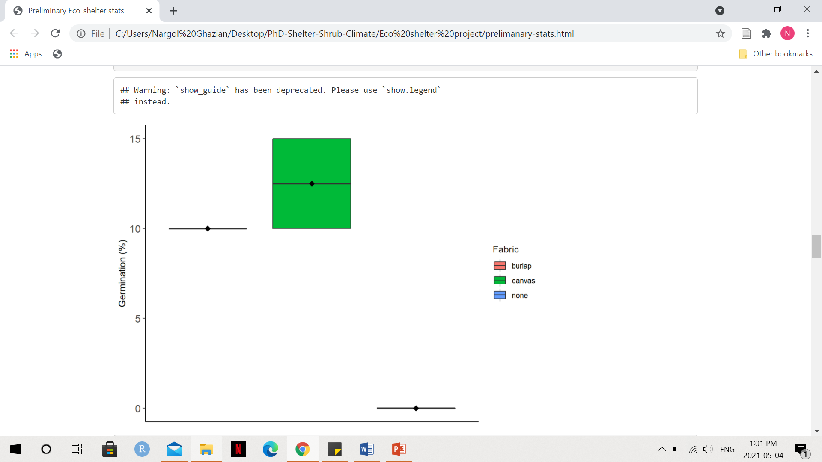

Slide 22
Main Objectives
Identify key sampling designs with camera traps.
Record microclimatic impacts of eco-friendly materials and their influence on plant species under controlled conditions.
Demonstrate ecological effects of shelters in the field.
Compile frequency and ecological strength of microclimate facilitation reported in the literature.

Slide 23
Chapter 3: The impact of artificial shelter deploys on microclimate and patterns in animal habitat usage.

Slide 24
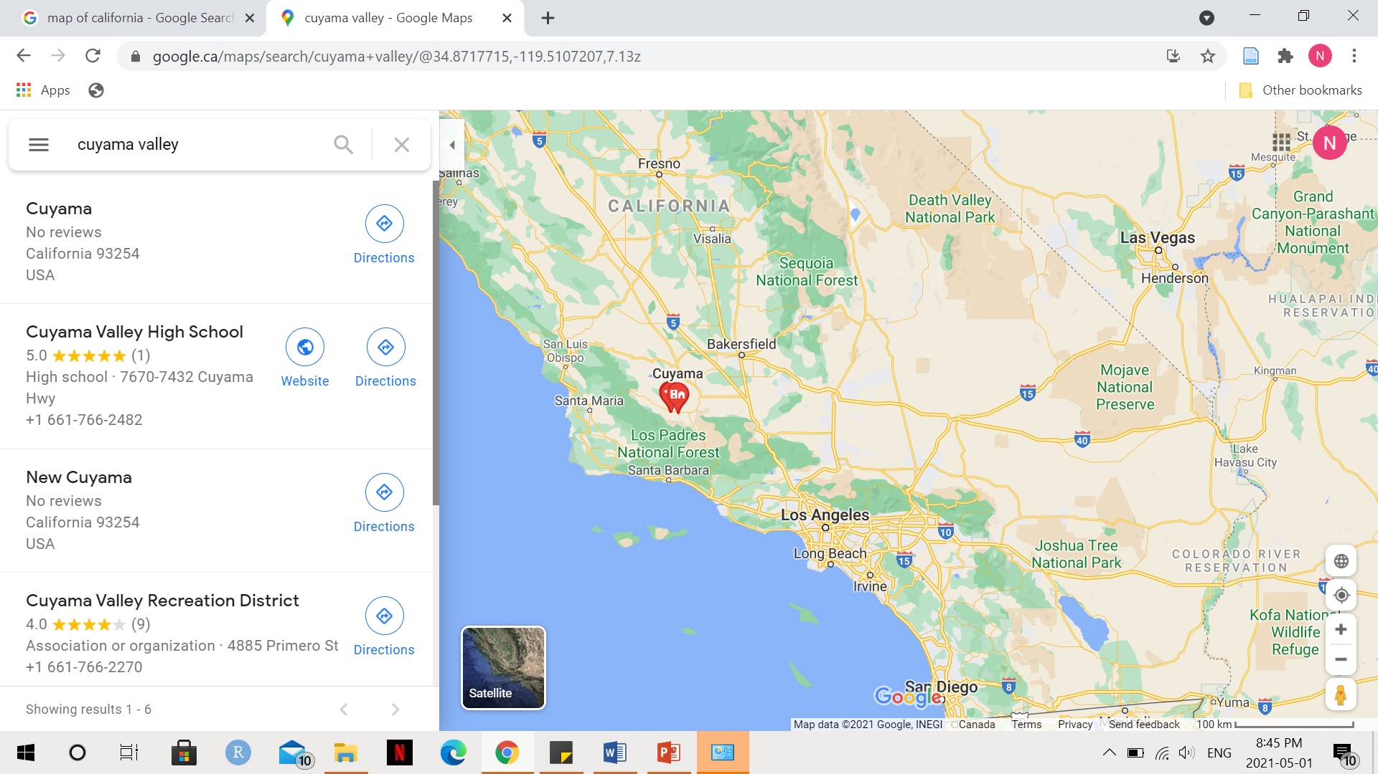

Slide 25
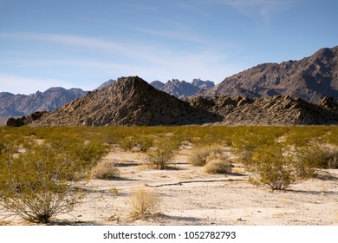

Slide 26
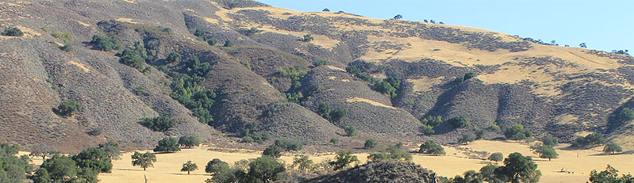

Slide 27
Purpose: To examine wildlife interactions with artificial shelters and to investigate how artificial shelters impact the soil microbial community.
Questions: How do UV permeable artificial shelters modify the soil microbial community richness and abundance? How often do vertebrates interact with artificial shelters? Which species interact with shelters the most often? What are they doing when interacting with shelters? Do arthropods interact with shelters? If yes, which species do most often? Does the richness and abundance of microbes differ between shelters, shrubs, and the open gap? Is the frequency and direction of vertebrate and arthropod interaction with shelters different from shrubs and the open?
Hypothesis: Animals will associate more with shelter microsites and shrubs than the open as canopied microsites ameliorate the microclimatic environment of the understory.

Slide 28
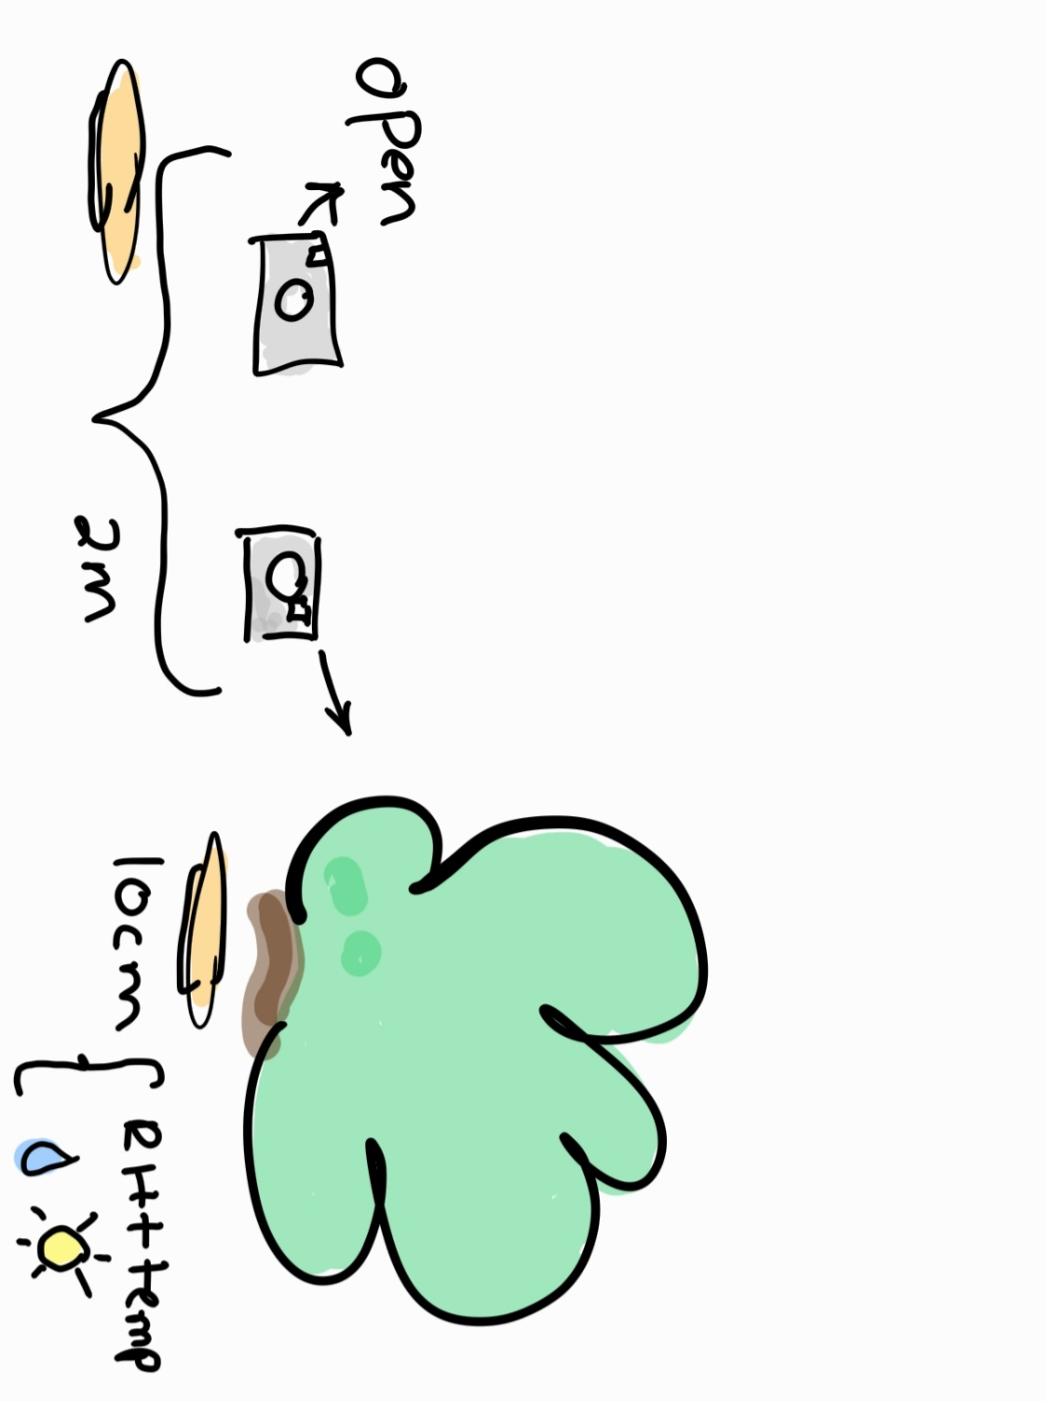
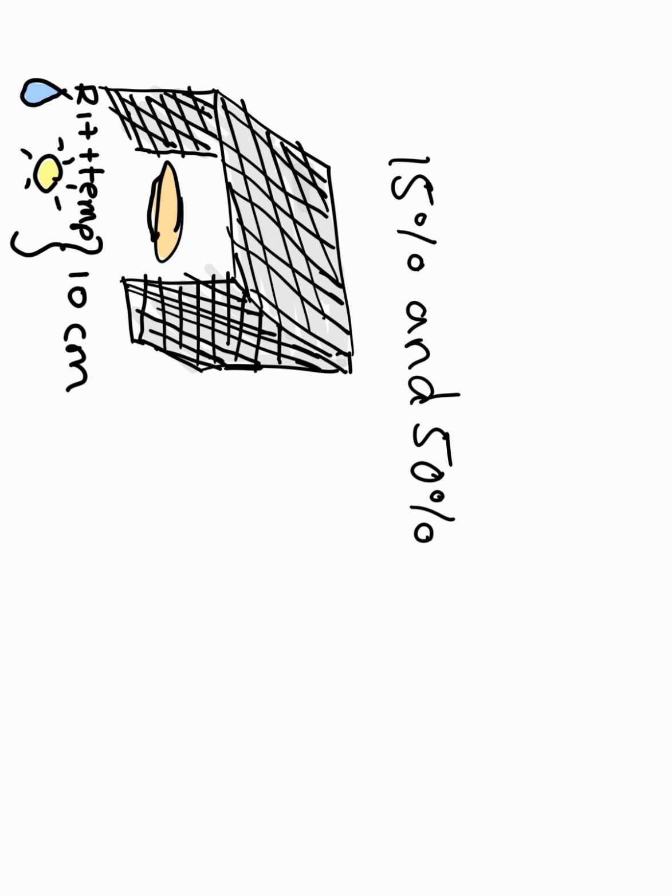
Winning Fabric
12 shelters
12 shrubs/open
Notes:
Winning Fabric

Slide 29
Chapter 4: Effects of shelter on understory plant germination.

Slide 30
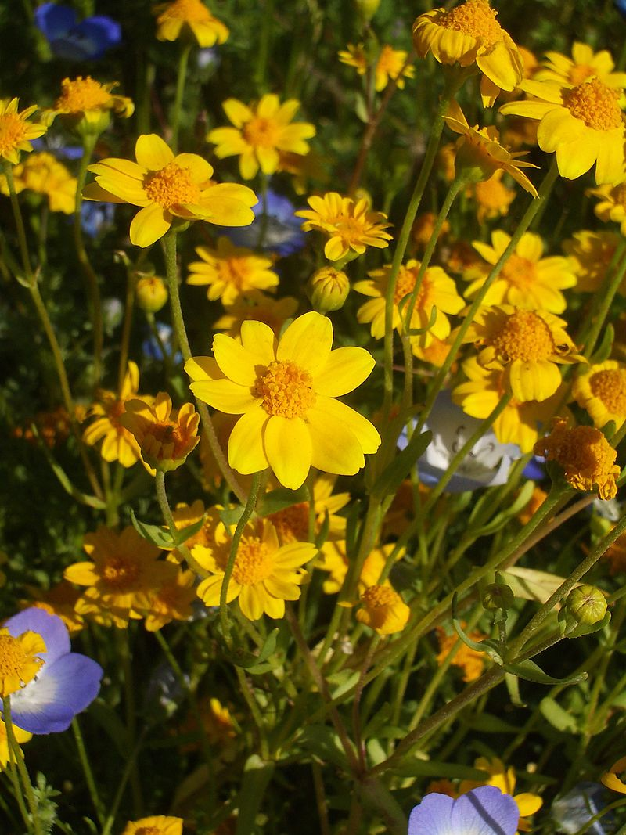
Possible Plants Species
?
Lasthenia californica
Phacelia tanacetifolia

Slide 31
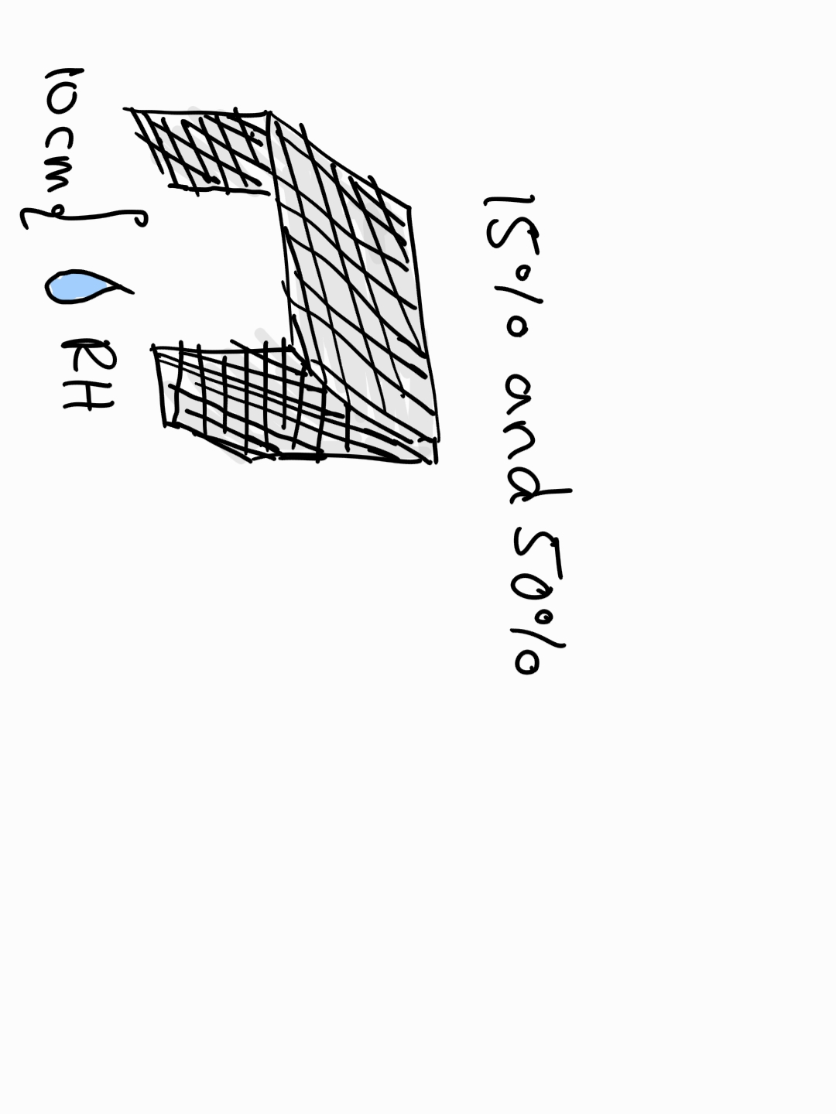
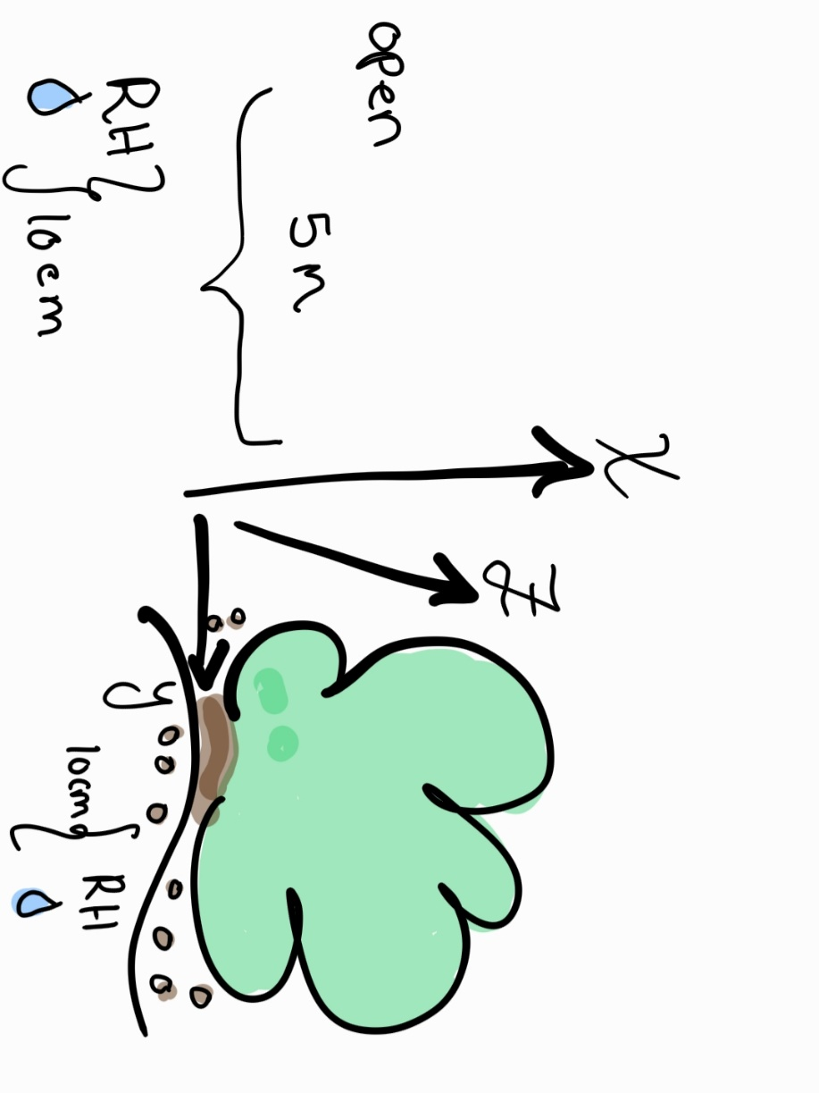
Water the microsite regularly
12 shelters
12 shrubs/open

Slide 32
Main Objectives
Identify key sampling designs with camera traps.
Record microclimatic impacts of eco-friendly materials and their influence on plant species under controlled conditions.
Demonstrate ecological effects of shelters in the field.
Compile frequency and ecological strength of microclimate facilitation reported in the literature.

Slide 33
Chapter 5 (Bonus): A synthesis of shelter amelioration for animals.

Slide 34
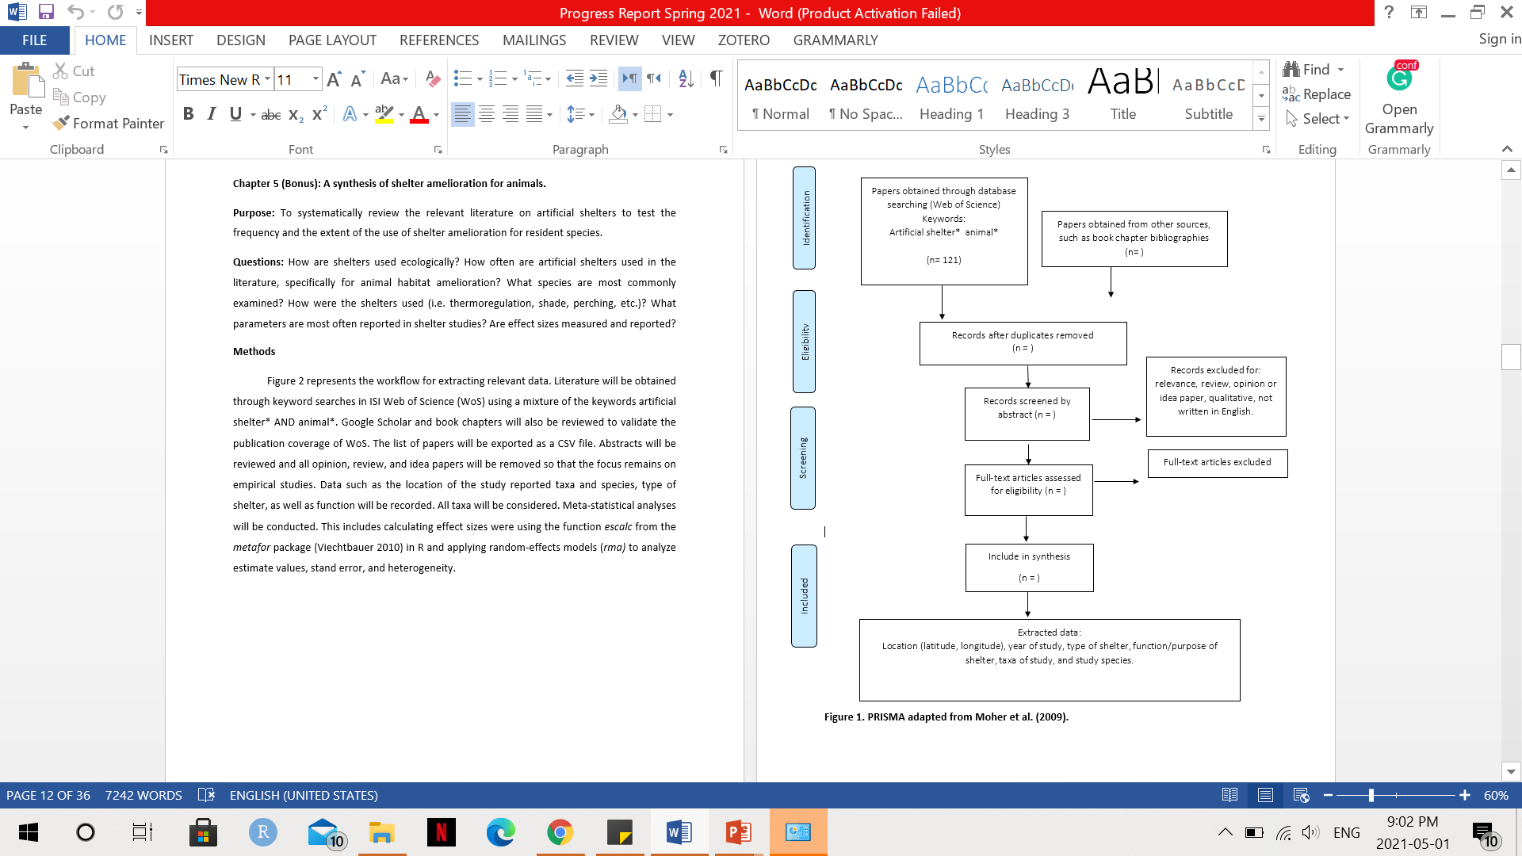

Slide 35
Timeline | Chapter | What needs to be done
May | Chapter 1 | Edit Submit to MEE
Late June-August | Chapter 2 | Finish lab experiment Statistical analyses Write first draft Submit to Journal
Late July/August-December/January | Chapter 5 | Start systematic review and compile data Do some stats Maybe write first draft
February-March prep April- | Chapter 3 and 4 | First field season 2022 One site: Mojave
 | Chapter 3 and 4 | Second field season 2023 Cuyama

Slide 36
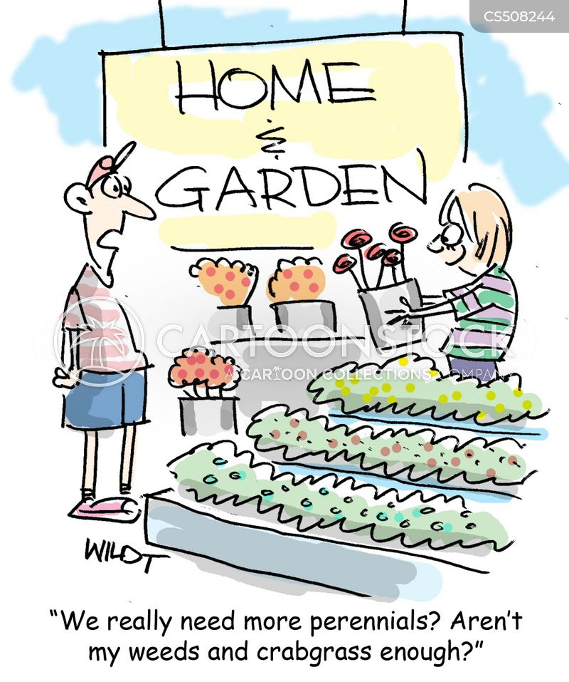
Thank You!

